Slide 1

LoRa Guard – A Smart Mining Helmet
G. Pullaiah College of Engineering and Technology
(Department of IoT)
By –
K. Lakshmi Pavan Kumar Sarma(20AT1a3522)
D. Rahul Koundinya (20AT1a3539)
M. Taufeeq (20AT1A3553)
G. Venkat Sai Tarun (20AT1A3559)
Under the Guidance of –
K. VinodKumarReddy M. Tech
Project Co-Ordinator –
Dr. C. Veena M. Tech, PhD
Head of the Department –
P. Suman Prakash M. Tech, PhD

Slide 2

Table of Content
01
Abstract
05
Proposed Model
09
Pseudo Code
02
Introduction
06
System Requirements
10
Screenshots
03
Literature Survey
07
UML Diagram
11
Future Enhancement
04
Existing Model
08
Methodology
12
Conclusion

Slide 3

Abstract
This project entails a sensor network utilizing LoRa SX1278 modules to transmit data from various environmental sensors connected to ESP8266 microcontrollers. The data is processed and displayed on Thingspeak and a mobile app developed using MIT App Inventor. Additionally, alerts are sent via Telegram bot if certain thresholds are exceeded. Furthermore, hand gesture recognition using an ESP32 CAM module and Spyder IDE provides real-time feedback on safety conditions.

Slide 4
Introduction
This project integrates hardware components such as ESP8266, DHT11, MQ135, GPS, LoRa SX1278, and ESP32 CAM with software components including Arduino IDE, Spyder IDE, Thingspeak, MIT App Inventor, and Telegram Bot. It aims to establish a comprehensive environmental monitoring and safety system. Data collected from sensors is transmitted via LoRa to Thingspeak for visualization on a mobile app. In cases of hazardous conditions, alerts are sent through Telegram. Additionally, hand gesture recognition using ESP32 CAM provides an additional layer of safety assessment.

Slide 5
Literature Survey
LoRa WAN, ideal for mining, covers vast areas with minimal gateways, enabling smart helmets to monitor miner safety efficiently, enhancing productivity.
1. Khan et al. In a 2022 survey, highlighted various advantages, including enhanced safety through the monitoring of hazardous gases, dust particles, and impacts on miners' heads. Additionally, LoRa WAN facilitates increased productivity by tracking miner locations and monitoring their work environments, aiding in better mine planning and workflow optimization. Furthermore, the cost-effectiveness of LoRa WAN technology contributes to reduced deployment and maintenance expenses for smart mining helmet networks. The remarkable smart mining helmet created by Wang and colleagues harnesses the power of LoRa WAN technology.
2. Srinivasa Rao et al. (2022) designed a smart mining helmet integrated with LoRa WAN, monitoring air quality, temperature, humidity, miner location, and impacts. The built-in communication system facilitated smooth communication between miners and supervisors. Testing in a simulated mining environment demonstrated its effectiveness in enhancing both miner safety and productivity.
3. Cheng and Sun (2009) developed a prototype ZigBee-based intelligent helmet that can be used to monitor methane gas levels, temperature, and humidity in underground mines. The helmet also includes a voice communication system that allows miners to communicate with each other and with mine operators.

Slide 6
Literature Survey
4. Hui (2009) developed a ZigBee-based wireless mine supervising system that uses intelligent helmets as voice terminals and ultra-low-power nodes of a wireless sensor network. The system can be used to monitor methane gas levels, temperature, and humidity in underground mines, and to provide early warnings to miners and mine operators in the event of hazardous conditions.
5. Manusmare (2017) developed a microcontroller-based smart helmet for coal miners safety. This helmet includes sensors to monitor methane gas levels, temperature, humidity, and impact.
6. Li et al. (2015) designed and implemented a ZigBee-based wireless mine monitoring system. The system includes sensors to monitor methane gas levels, carbon monoxide levels, temperature, humidity, and air pressure.
7. Wang et al. (2016) developed a ZigBee-based wireless sensor network for coal mine safety monitoring. This system includes sensors to monitor methane gas levels, temperature, humidity, and carbon monoxide levels.
8. Zhang et al. (2018) developed a ZigBee-based wireless sensor network for underground coal mine safety monitoring. This system includes sensors to monitor methane gas levels, temperature, humidity, and carbon monoxide levels.

Slide 7
Existing Model
An innovative mining helmet, powered by IoT and AI technologies, integrates sensors and an STM32 module for enhanced safety in coal mines. It continuously monitors ambient conditions and worker health parameters, transmitting data to a control center via low-energy Bluetooth for risk alerts. Incorporating DHT11 and MQ135 sensors ensures accurate environmental monitoring, while a machine learning algorithm with a convolutional neural network recognizes worker gestures, aiding communication. The system's implementation promises to significantly reduce mortality rates and disease alerts by promptly notifying workers of potential dangers, with future enhancements including cloud integration and LoRaWAN module utilization for network efficiency.

Slide 8
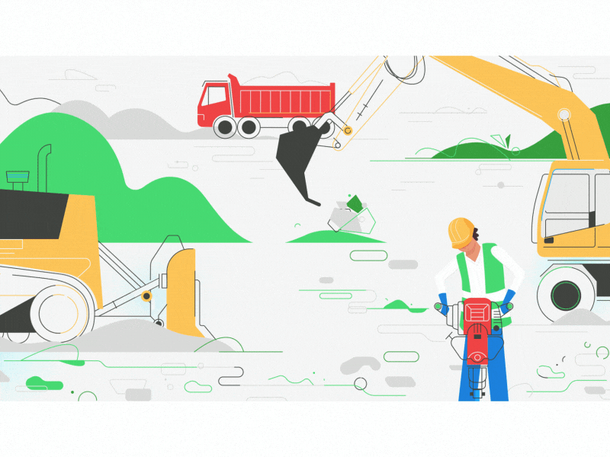
Proposed Model
On the sender side, the LoRa SX1278, which is connected to the ESP8266, collects data from the DHT11, GPS, and MQ135 sensors (all connected to the ESP8266) and pushes this data to Thingspeak. The data from Thingspeak is displayed in a mobile app developed using MIT App Inventor. Whenever the temperature and toxic gas values exceed their threshold values, an alert is sent to a Telegram bot. Additionally, the sender-side LoRa SX1278 transmits data to the receiver-side LoRa SX1278, which is connected to another ESP8266. The ESP32 Cam, powered by a separate power source, runs and generates a URL. This URL is then pasted into Spyder IDE. The ESP32 Cam detects hand gestures and displays "OK," "NOT OK," or "DANGER" in the console.

Slide 9
System Requirements
Hardware Components:
Sender Side:
ESP8266
DHT11 sensor
MQ135 sensor
GPS module
LoRa SX1278 module
ESP32-CAM module
Receiver Side:
ESP8266
LoRa SX1278 module
Software Components:
Arduino IDE: Used for programming ESP8266 and ESP32-CAM microcontrollers.
Spyder IDE: Utilized for Python programming to process image data and detect hand gestures.
Thingspeak: Cloud platform used to collect and display sensor data from the sender side.
MIT App Inventor: For developing the mobile application to display data from Thingspeak.
Telegram Bot: Used for sending alerts when temperature and toxic gas values exceed threshold values.

Slide 10
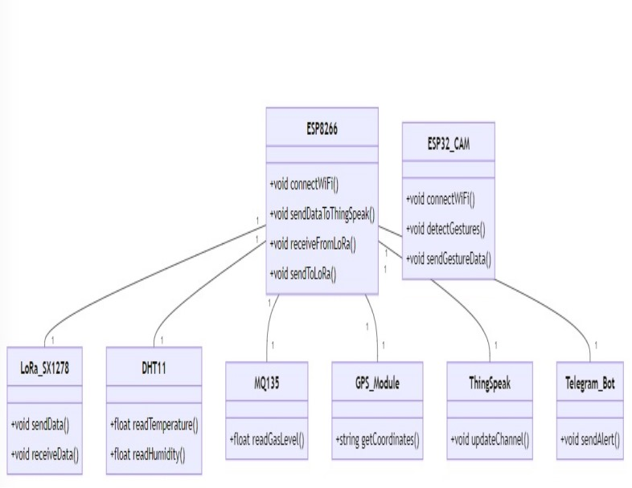
UML Diagrams
Class Diagram

Slide 11
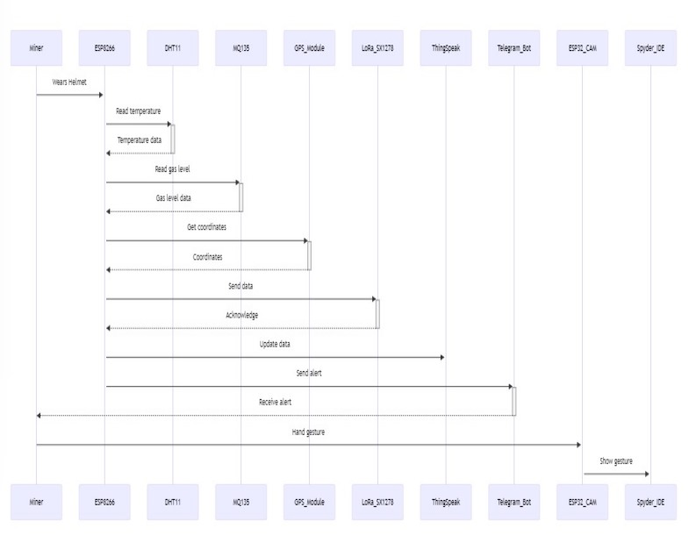
UML Diagrams
Sequence Diagram

Slide 12
UML Diagrams
Activity Diagram

Slide 13
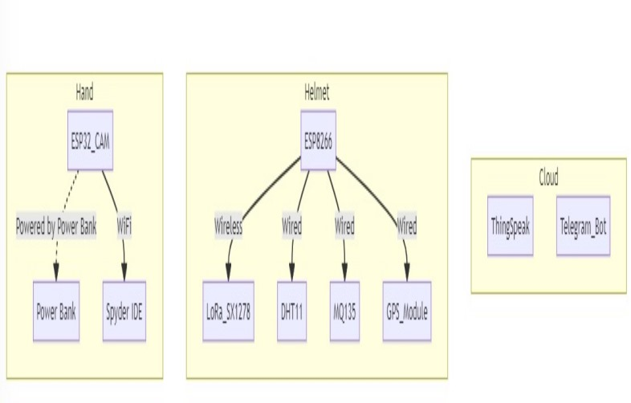
UML Diagrams
Deployment Diagram

Slide 14
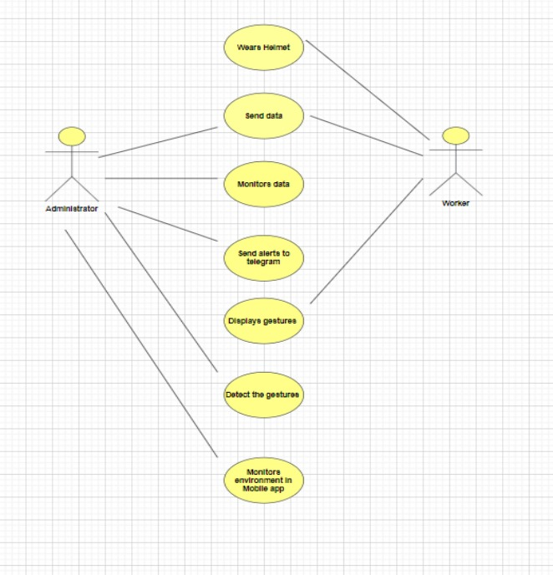
UML Diagrams
Usecase Diagram

Slide 15
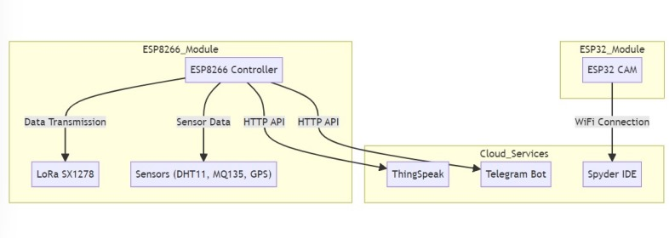
UML Diagrams
Components Diagram

Slide 16
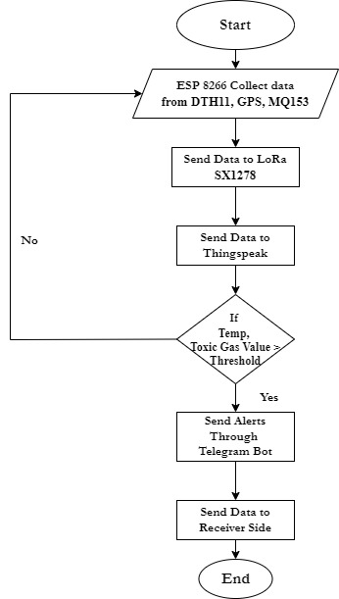
Methodology

Slide 17
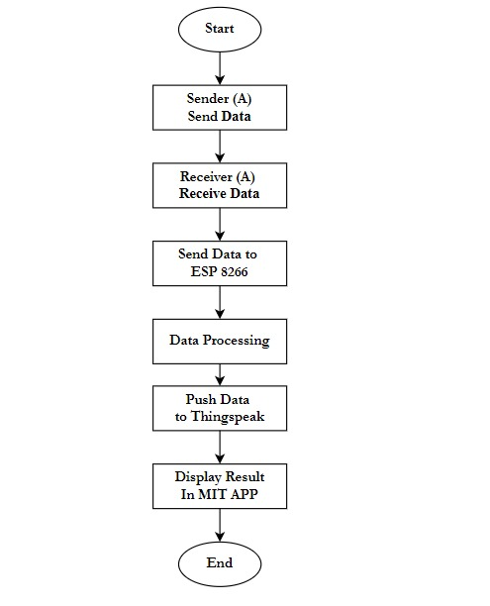
Methodology

Slide 18
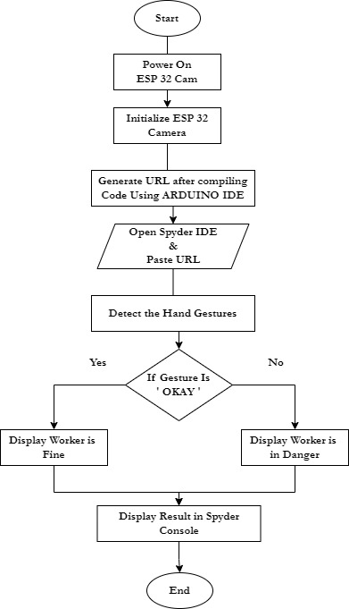
Methodology

Slide 19
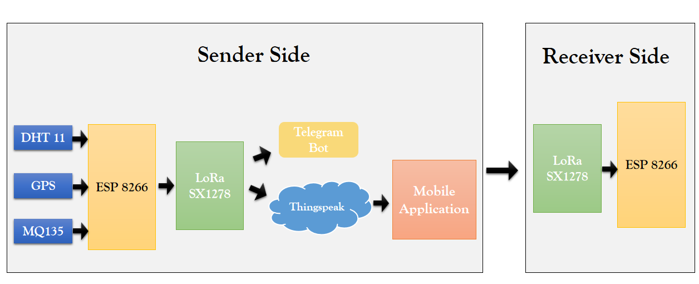
Methodology
Module 1 :

Slide 20
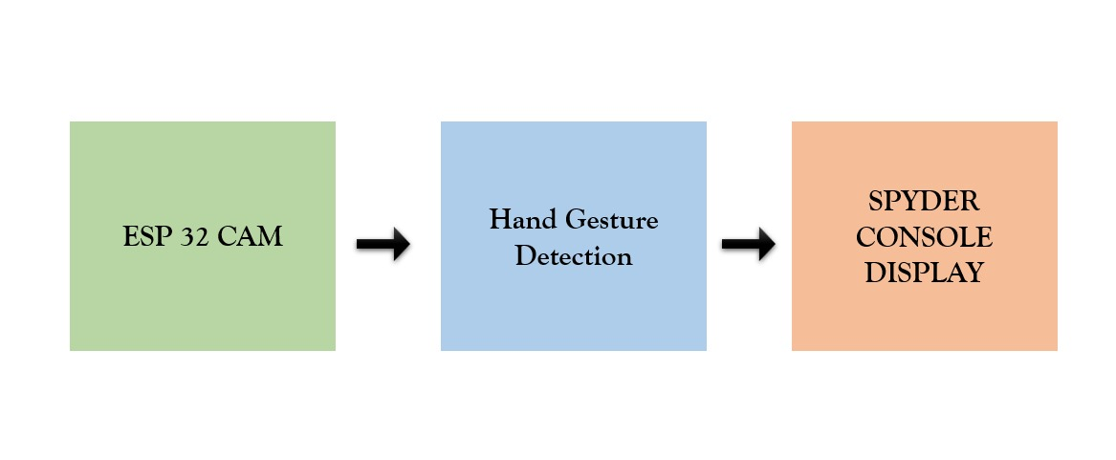
Methodology
Module 2 :

Slide 21
Pseudo Code
// Include necessary libraries
#include <DHT.h>
#include <MQ135.h>
#include <SoftwareSerial.h>
#include <TinyGPS++.h>
#include <LoRa.h>
#include <ESP8266WiFi.h>
#include <WiFiClient.h>
#include <ThingSpeak.h>
// Define pin connections
#define DHTPIN 2
#define DHTTYPE DHT11
#define RX_PIN 12
#define TX_PIN 13
#define GPS_RX 14
#define GPS_TX 15
#define LORA_SS 16
#define LORA_RST 17
#define LORA_DI0 18
#define MQ_PIN A0
// Define threshold values
#define TEMP_THRESHOLD 25
#define TOXIC_THRESHOLD 100
// Define WiFi credentials
const char *ssid = "YOUR_SSID";
const char *password = "YOUR_PASSWORD";
// Define ThingSpeak credentials
unsigned long channelID = YOUR_CHANNEL_ID;
const char *writeAPIKey = "YOUR_WRITE_API_KEY";
// Initialize sensors
DHT dht(DHTPIN, DHTTYPE);
MQ135 mq(MQ_PIN);
TinyGPSPlus gps;
SoftwareSerial espSerial(RX_PIN, TX_PIN); // RX, TX
WiFiClient client;

Slide 22
Pseudo Code
// Initialize ThingSpeak
ThingSpeak.begin(client);
// Initialize sensors
dht.begin();
mq.begin();
void loop() {
// Read sensor data
float temperature = dht.readTemperature();
float humidity = dht.readHumidity();
float toxicGas = mq.readCO2();
// Check if temperature or toxic gas exceeds threshold
if (temperature > TEMP_THRESHOLD || toxicGas > TOXIC_THRESHOLD) {
sendTelegramAlert(temperature, toxicGas);
}
// Send data to ThingSpeak
sendDataToThingSpeak(temperature, humidity, toxicGas);
// Send data to receiver LoRa
sendToReceiverLoRa(temperature, humidity, toxicGas);

Slide 23
Pseudo Code
void setup() {
// Initialize serial communication
Serial.begin(9600);
espSerial.begin(9600);
// Initialize LoRa
LoRa.setPins(LORA_SS, LORA_RST, LORA_DI0);
if (!LoRa.begin(433E6)) {
Serial.println("LoRa initialization failed. Check your connections.");
while (1);
}
// Connect to WiFi
WiFi.begin(ssid, password);
while (WiFi.status() != WL_CONNECTED) {
delay(1000);
Serial.println("Connecting to WiFi..");
}

Slide 24
Pseudo Code
// Check for GPS data
while (espSerial.available() > 0) {
if (gps.encode(espSerial.read())) {
if (gps.location.isValid()) {
double latitude = gps.location.lat();
double longitude = gps.location.lng();
// Use latitude and longitude
}
}
}
// Detect hand gestures using ESP32-CAM and Spyder IDE
// Generate URL and send it to ESP32-CAM
delay(10000); // Delay for 10 seconds
}
void sendTelegramAlert(float temperature, float toxicGas) {
// Send alert message to Telegram bot
}

Slide 25
Pseudo Code
void sendDataToThingSpeak(float temperature, float humidity, float toxicGas) {
// Write data to ThingSpeak
ThingSpeak.writeField(channelID, 1, temperature, writeAPIKey);
ThingSpeak.writeField(channelID, 2, humidity, writeAPIKey);
ThingSpeak.writeField(channelID, 3, toxicGas, writeAPIKey);
}
void sendToReceiverLoRa(float temperature, float humidity, float toxicGas) {
// Send data to receiver LoRa
}

Slide 26
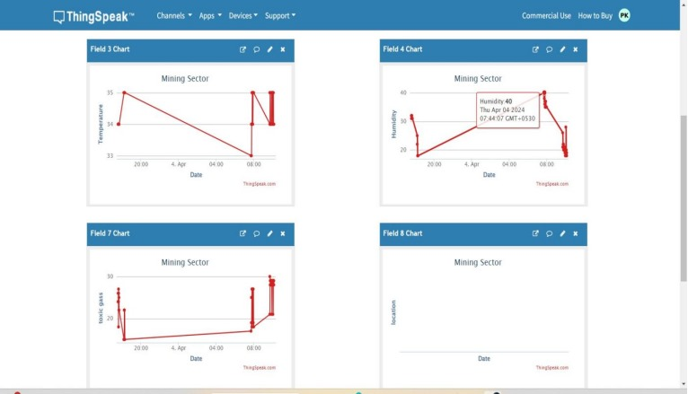
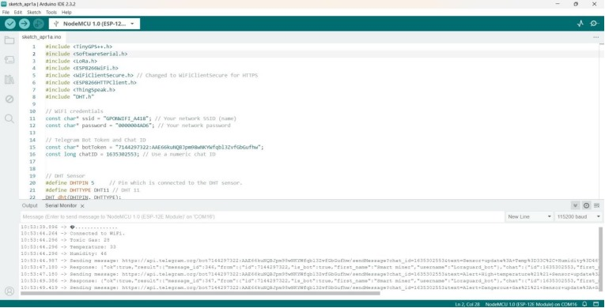
Screenshots

Slide 27
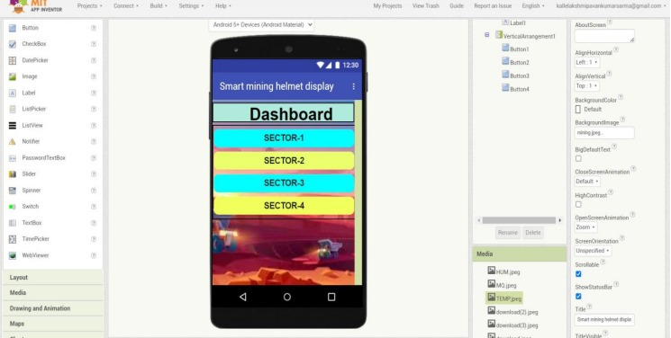
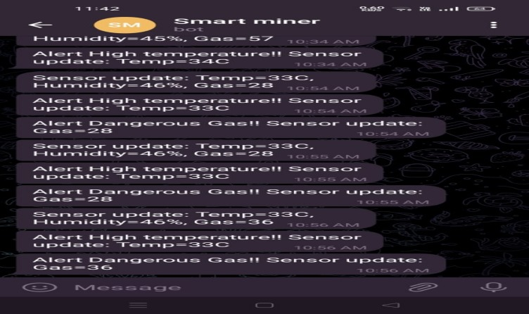
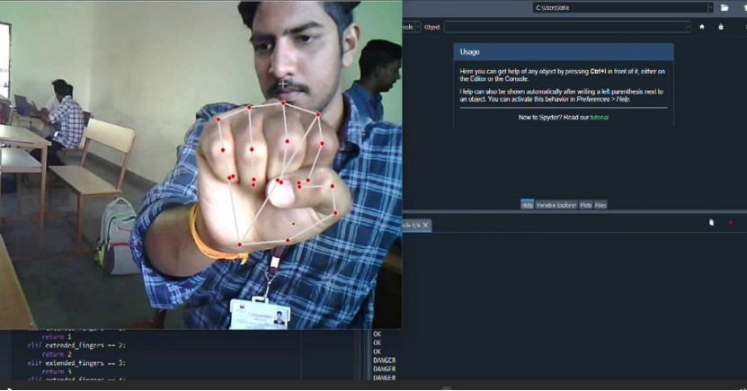
Screenshots

Slide 28
Future Enhancement
Incorporating AR into the helmets could provide workers with vital information directly in their field of vision. This could include escape routes during emergencies, real-time hazard warnings, or even instructions for equipment operation. Future versions of the helmet could incorporate energy-harvesting technologies, such as solar cells or thermoelectric generators, to extend battery life or even provide a self-sustaining power source. The data collected from various sensors can be used to create virtual reality (VR) simulations for training purposes. These simulations can replicate real-life scenarios based on actual data, providing miners with immersive and practical safety training

Slide 29

Conclusion
In conclusion, the smart mining helmet, integrating IoT and AI, enhances worker safety by monitoring ambient conditions and health parameters via an LoRa module. Low-energy Bluetooth facilitates real-time data transmission, triggering alerts and a panic button. DHT11 and MQ135 sensors ensure accurate environmental monitoring. Machine learning recognizes gestures for improved communication, while the Receiver API enables informed decision-making. Future plans include cloud integration for comprehensive analysis and proposing a LoRaWAN module to minimize network dependence in mining transmissions. Together, these advancements demonstrate a commitment to elevating worker safety and operational efficiency in mining.

Slide 30
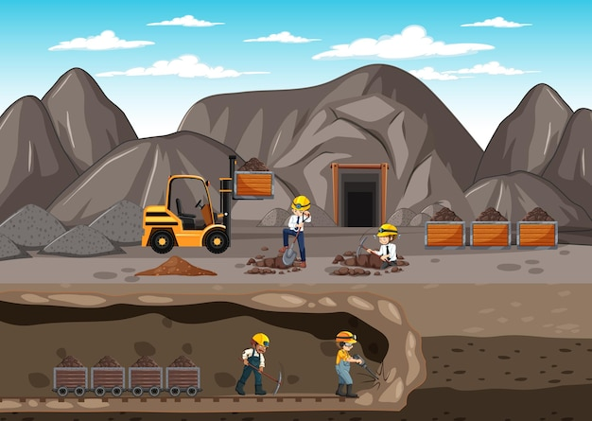
Thank You

